Slide 1

Commercial Deployment

Slide 2

Overview
Why OneLoup – connecting FSP’s in a realtime, interoperable & secure platform
Seamless transactions amongst wallets and bank accounts
For individual and business transactions
Meeting the UN SDG of fees below 3% of face – zero fee for low value trx

Slide 3

Leveraging Mojaloop
Core Mojaloop adoption
The OneLoup Cross Border Platform
The OneLoup white label domestic realtime retail payment system
Building upon what’s been done
Multicurrency, settlements, rules, security, licensing
Additional products & services | eWallet, multicurrency accounts, loans, insurance, investments, payment gateway solutions for eComm.
Business solutions like escrow, bank guarantees, LC’s, insurance, working capital, etc

Slide 4
Opportunities
P2P - $650 Billion market
The 2 Billion unbanked
Financial Inclusion by bringing them on the digital platform, establishing a credit rating, offering them financial products (OTC does not offer this)
Banks account for less than 10% of transactions (MTO dominated, teller dependent)
Focus on STP transactions
Low fees – below the UN SDG 3% threshold
Rebate model example
Zero fees for low value transactions
Micro Savings & Insurance plans
Multi-targeted transactions enabling, bill payments, education, medical, investments (real-estate), apart from family fund transfers
Ability to Pull transactions as well – request to Pay, in addition to Push transactions
Recurring payments instructions for automatic transfers on pre-determined dates, etc

Slide 5
Opportunities
SME Business - $15 Trillion market ($125 T total)
High costs
Many intermediary banks – hops
Lack of visibility on costs and timing
Lack of transaction traceability
Speed issues – several days, working capital
Mojaloop
One standardized connection, increased transparency, resiliency & fraud protection, reduced costs, speed, rich data transfer

Slide 6
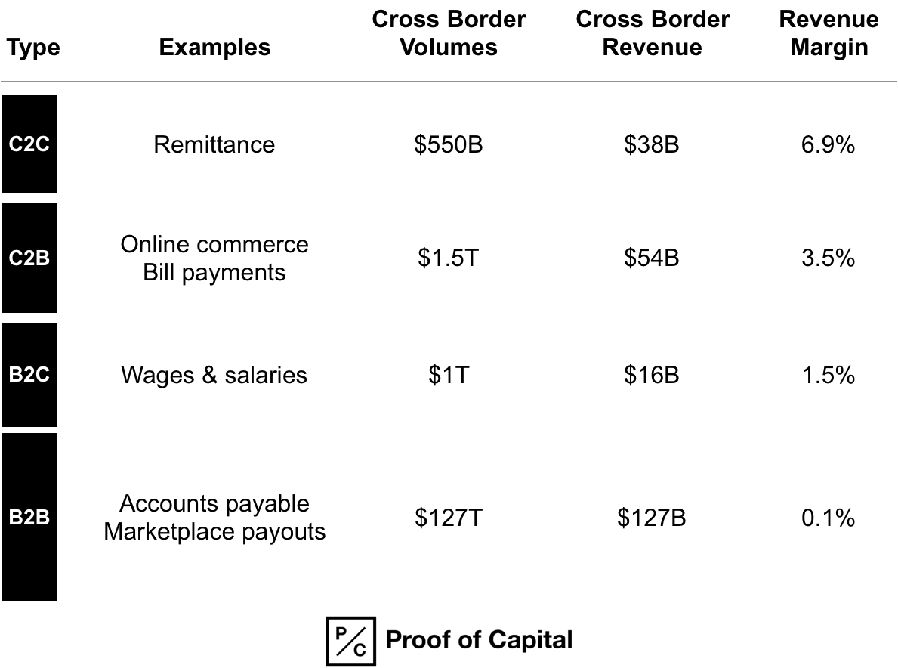
Market Size

Slide 7
Giving back
Early stages
Business rules
Global & country level compliance rules
Code
Progress updates
Collaboration at the Mojaloop Foundation level
Thank you

